Slide 1
Python for High Performance Computing
Exascale Computing Project 2nd Annual Meeting
William Scullin (ALCF), Matt Belhorn (OLCF), and Rollin Thomas (NERSC) Knoxville, Tennessee February 5, 2018

Slide 2
Agenda
Introductions, Agenda, and Logistics
Why this tutorial and why Python?
Using Python at NERSC, ALCF, and OLCF
Hands on 1: Logging into NERSC’s Cori and setting up an environment
Performance Basics: Threading Issues ● NumPy ● Extending Python
Python Parallelism: MPI with mpi4py ● Caveats
I/O Overview
Hands-on 2: Using mpi4py
Profiling Python code
Debugging Overview
Hands-on with your code and Q&A
Other Resources
Notes:
We will pause for 1-2 questions at each breakpoint, we will manage Q&A with a shared Google doc… or something.

Slide 3
Administrative and Logistical Notes
SAFETY: Please note emergency exit locations and watch for bags and cords to avoid tripping hazards
There is a shared Google Doc for asking questions and sharing code snippets: http://bit.ly/2018ecppythontutorialshareddoc we will add a copy to the repo with slides and materials after the tutorial
We will be doing hands-on exercises on NERSC Cori. If needed, training accounts are available. (Thanks NERSC!) Please see Matt or William at the first hands on if you didn’t get setup before the tutorial started.
Slides and materials are available at: LINK HERE
The materials are an amalgamation of a decade of community efforts by volunteers. Formatting might be wonky, but the information isn’t.
Please ask questions. We’ll be watching the room and the Google Doc.

Slide 4
Tutorial Objectives
What we want to do:
Briefly explain what ALCF, NERSC, and OLCF are doing to welcome and support Python users in HPC.
Provide guidance and best practices for using Python in a HPC context.
Reveal common stumbling blocks that impact performance.
Introduce some great tools that now exist to support developers using Python in HPC settings.
What we assume:
You know and use Python
You have some familiarity with the Scientific Python Stack, or
You know and use HPC resources and are curious about using Python in your own HPC work.

Slide 5
Why this tutorial? Why Python?

Slide 6

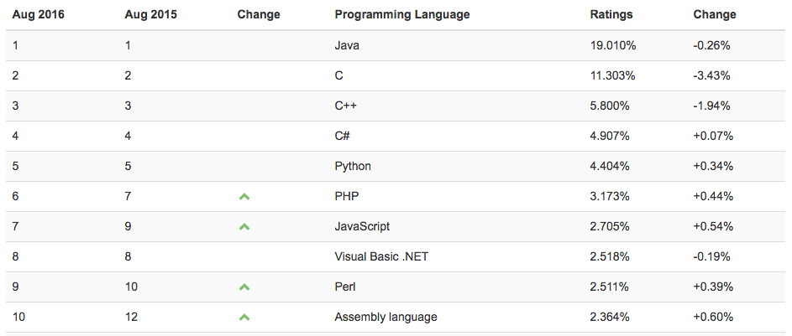
Why this tutorial?
Python is popular
It’s becoming the de facto language for data science
It’s behind a large number of scientific workflows
It’s not uncommon for prototyping or even implementing production software
bestprogramminglanguagefor.me
http://www.tiobe.com/tiobe-index
codeval.com

Slide 7
Why Not Python?
Performance is often a secondary concern for developers and distributions
Most Python developers aren’t in HPC environments
Most Python developers aren’t in science environments
Many tools were designed to work best in generic environments
Language maintainers favor consistency over compatibility
Backwards compatibility is seldom guaranteed
Low learning curve
It’s easy to develop a code base that works, but won’t scale
Sometimes Python isn’t the right tool
Existing investments in commercial high-productivity languages (e.g. Matlab)

Slide 8
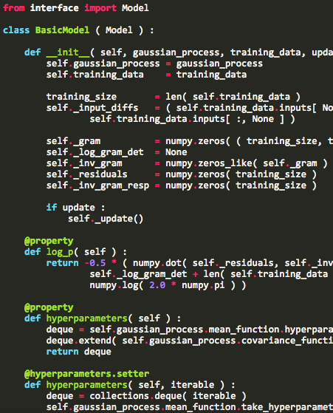
Why is Python Popular?
Makes a great first impression:
Clean, clear syntax.
Multi-paradigm, interpreted.
Duck typing, garbage collection.
Built-ins mostly map to C/C++ equivalents.
Excellent built-in documentation.
Keeps up with users’ needs:
Flexible, full-featured data structures.
Extensive standard libraries.
Portable.
Fully open source with a strong development community.
Commercial support available.
Reusable open-source packages (PyPI).
Package management tools.
Good unit testing frameworks.
Extensible with C/C++/Fortran for optimizing high-performance kernels.

Slide 9


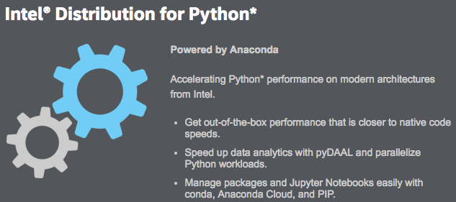






The Scientific Python Stack
Primary Uses:
Script workflows for both data analysis and simulations
Perform exploratory, interactive data analytics & viz

Slide 10
Choosing between Python 2 or 3
Python was originally developed as a system scripting language for the Amoeba distributed operating system and has been developing ever since, with many backwards-incompatible changes made in the name of progress without too much delay on adoption. However, the changes from Python 2 to Python 3 were sufficiently radical that adoption has been slow going. That said:
Python 3 is the future – and the future is here
All major libraries now work under Python 3.5+
Almost all popular tools work with Python 3.5+
Python 3’s loader and more of the interpreter’s internals are written in Python
This makes loading more I/O intensive which presents challenges for scaling
It also makes it easier to write alternative interpreters that can be faster than CPython

Slide 11
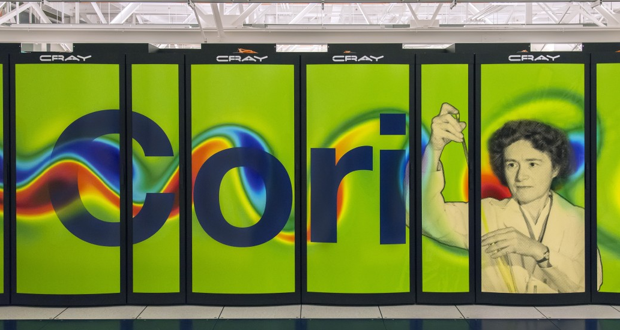
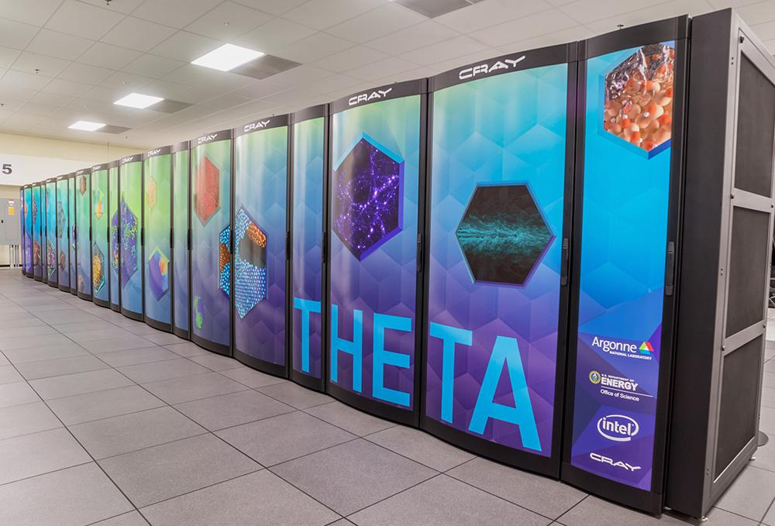

Python at the HPC Center
Observation: High productivity has driven the growth of Python in the sciences. ...Not high performance (so much).
But supporting Python is no longer optional at HPC centers like NERSC, ALCF, OLCF.
Maximizing Python performance on these systems can be (ok, is) challenging:
Interpreted, dynamic languages can be difficult to optimize.
Python’s global interpreter lock (GIL) has consequences for parallelism.
Language design and implementation choices made without considering realities of HPC.

Slide 12
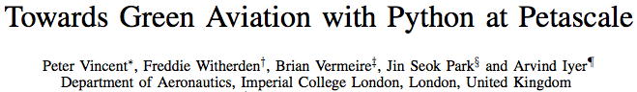

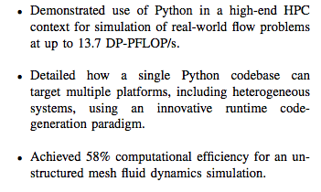
PyFR: Gordon Bell & SC16 Best Paper Finalist
Performance portability enabled by Python: CFD from a single code base supporting CPU and GPU architectures, a few x1000 lines of code.
Python can be at the highest levels of performance in supercomputing.
[http://sc16.supercomputing.org/2016/08/23/finalists-compete-prestigious-acm-gordon-bell-prize-high-performance-computing/]
[http://sc16.supercomputing.org/2016/09/21/sc16-announces-best-paper-nominees]

Slide 13
Basic Guidelines for Python in HPC
Identify and exploit parallelism at the core, node, and cluster levels.
Control your environment and check for correctness.
Understand and apply numpy array syntax and its broadcasting rules (skipped here): https://docs.scipy.org/doc/numpy/reference/arrays.html https://docs.scipy.org/doc/numpy/user/basics.broadcasting.html
Use mpi4py appropriately.
Use community solvers.
Measure your codes’ performance using profiling tools.
Develop tests.
Be part of the community.

Slide 14
Practical Matters:
Using Python at NERSC, ALCF, and OLCF

Slide 15
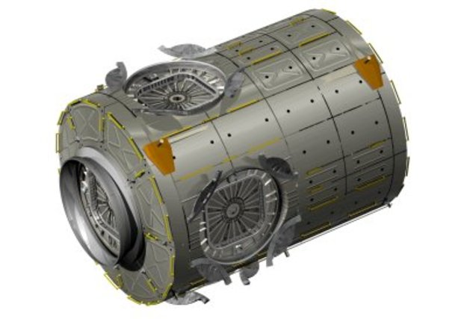
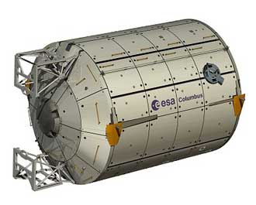
Python at NERSC, ALCF, & OLCF
python 2.7
python 3.5
Where do users commonly find Python on HPC systems?
Environment Modules http://modules.sourceforge.net “The Environment Modules package provides for the dynamic modification of a user's environment via modulefiles.”
module avail python module load python module swap python/2.7 python/3.5 module help…
Installing their own Python (many options).
System Python (e.g. /usr/bin/python) use system Python at your own risk.

Slide 16



Python Builds and Distributions
Centers may build, install Python & packages from:
source
package managers like Spack* https://spack.readthedocs.io/en/latest/
using distributions like:
Anaconda https://docs.continuum.io/anaconda/
Intel Python https://software.intel.com/en-us/distribution-for-python
Enthought Canopy https://www.enthought.com/product/canopy/
or all of the above.
Centers also let users set up their own!
Packages depending on MPI should always be built against system vendor-provided libraries.
Anaconda distribution comes with Intel MKL built-in.
Intel distribution heavily leverages Anaconda tools.
[* Spack is also featured here at the ECP 2nd Annual Meeting!]

Slide 17
Customizing and Controlling Your Environment I: Virtualenv
User-controlled isolated python environments
Almost universally used outside of science
Site packages root under your control
Activated venvs preclude other python interpreters
Semi-conflicts with environment modules
Setup environment modules prior to activation
$ virtualenv -p python2.7 /path/to/my_env $ . /path/to/my_env/bin/activate (my_env)$ pip install --trusted-host \ pypi.python.org -U pip (my_env)$ CC=cc MPICC=cc pip install -v \ --no-binary :all: mpi4py (my_env)$ deactivate

Slide 18
Customizing and Controlling Your Environment I: Virtualenv (cont’d)
Using your packages with an external interpreter:
Install your own packages in your venv
Use them with external python within your python scripts
Mix-and-match with center-provided packages
#!/usr/bin/env python2.7 activate_this = '/path/to/env/bin/activate_this.py' execfile(activate_this, dict(__file__=activate_this))
N.B.: Packages installed in the venv will supercede versions installed at the site level.

Slide 19
Customizing and Controlling Your Environment II: Conda
Anaconda provides the conda tool for creating a Conda “environment”:
https://conda.io/docs/index.html
Create, update, share environments.
Incompatible with virtualenv, replaces it.
Many pre-built packages organized in custom “channels.”
Leverage your center’s Anaconda install to create custom environments with the conda tool.
Conda also works with your own Anaconda/“Miniconda” installation:
wget https://repo.continuum.io/miniconda/Miniconda2-latest-Linux-x86_64.sh
/bin/bash Miniconda2-latest-Linux-x86_64.sh -b -p $PREFIX
source $PREFIX/bin/activate
conda install basemap yt…
As well as with your own Intel Python installation:
conda create -c intel -n idp intelpython2_core python=2
source activate idp

Slide 20

Python at NERSC
NERSC-built:
module load python[/2.7.9]
python_base/2.7.9
numpy/1.9.2
scipy/0.15.1
matplotlib/1.4.3
ipython/3.1.0
Anaconda:
module load python/2.7-anaconda
module load python/3.5-anaconda
[default]
NERSC-built:
None
Anaconda:
module load [python/2.7-anaconda]
module load python/3.5-anaconda
[default]
Conda env via module (either system)
module load python/2.7-anaconda
conda create -n myenv numpy... source activate myenv
[http://www.nersc.gov/users/data-analytics/data-analytics/python/]

Slide 21
Python at ALCF
Every system we run is a cross-compile environment except Cooley
pip/distutils/setuptools/anaconda don’t play well with cross-compiling
Blue Gene/Q Python is manually maintained
Instructions on use are available in: /soft/cobalt/examples/python
Modules built on request
Theta offers Python either as:
Intel Python - managed and used via Conda
We prefer users to install their own environments
Users will need to set up their environment to use the Cray MPICH compatibility ABI and strictly build with the Intel MPI wrappers: http://docs.cray.com/books/S-2544-704/S-2544-704.pdf
ALCF Python managed via Spack and loadable via modules: module load alcfpython/2.7.13-20170513
A module that loads modules for NumPy, SciPy, MKL, h5py, mpi4py...
We build and rebuild alcfpython via Spack to emphasize performance and Cray compatibility
Use of virtualenv is recommended - do not mix conda and virtualenv!!!
We’ll build any package with a Spack spec on request

Slide 22

Python at OLCF
Provided interpreters:
module load python[/2.7.9]
python/3.5.1
Major Provided Packages:
python_numpy/1.9.2
python_scipy/0.15.1
python_matplotlib/1.2.1
python_ipython/3.0.0
python_mpi4py/1.3.1
python_h5py/2.6.0
python_netcdf4/1.1.7
Anaconda:
Prefer to build your own
Generally interferes with Tcl Environment Modules
Custom package install paths:
Prefer NFS project space /ccs/proj/${PROJECTID}
Take care with user site-packages, ${HOME}
Avoid /lustre/atlas
Further site-specific information on the OLCF Website
[https://www.olcf.ornl.gov/training-event/2016-olcf-user-conference-call-olcf-python-best-practices]
Notes:
Custom package install path recommendations reasonings:
Preferred: NFS project space
/ccs/proj/${PROJECT_ID}
Project-shared by default
Not purged
Mounted RO on Cray compute nodes
Home NFS space ($HOME, site.USER_SITE)
Convenient; not purged
Not mounted on Cray compute nodes, OK on Rhea
May conflict between resources/interpreters
Not shared with collaborators without effort
Avoid Atlas/Lustre scratch space
$PROJWORK, $MEMBERWORK, $WORLDWORK
Avoid for executables.

Slide 23
Hands-on Exercise 1: Setting up an environment on Cori
Instructions:
1. Ensure that you have an account. 2. Log in and verify you are in group ntrain: ssh train${N}@cori.nersc.gov train15@cori10:~> groups
train15 ntrain training
train15@cori10:~> salloc -N 1 -q regular -t 20 -C haswell \ --reservation=ecp_python -A ntrain
salloc: Granted job allocation 10011248
train15@nid00681:~> module load python/3.6-anaconda-4.4
train15@nid00681:~> which python
/usr/common/software/python/3.6-anaconda-4.4/bin/python 3.Create an environment conda create -n myenv numpy python=3
[installation messages]
source activate myenv 4. Install mpi4py env MPICC=$(which cc) pip install mpi4py
5. Check out the examples
git clone https://github.com/wscullin/ecp_python_tutorial.git

Slide 24
Performance Basics: Python Internals and Threading NumPy Extending Python

Slide 25
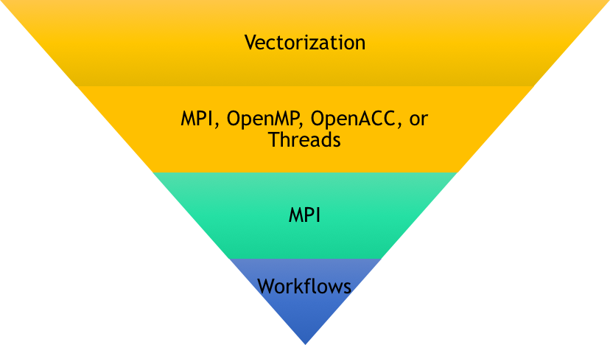
Structuring a HPC Python code
Share of execution time
Notes:
Like everything else, Python does best when kept in

Slide 26
How does CPython work?
Let’s look a a function to calculate the area of a circle as Python sees it.

Slide 27
How does CPython work? (Part 2)
Let’s use that to calculate an array of circle areas:
Notes:
Stack driven REPL loop that gets to handle random vars. This ignorance is one of the reasons that it’s hard to optimize Python: you don’t know when you’re compiling the code object and generating the bytecode what it’s going to end up doing. The compiler has no idea what’s going to happen. As Russell Power and Alex Rubinsteyn wrote in “How fast can we make interpreted Python?”, “In the general absence of type information, almost every instruction must be treated as INVOKE_ARBITRARY_METHOD.”

Slide 28
Can we improve things in pure Python?
List comprehensions seem to simplify things…
Notes:
Stack driven REPL loop that gets to handle random vars. This ignorance is one of the reasons that it’s hard to optimize Python: you don’t know when you’re compiling the code object and generating the bytecode what it’s going to end up doing. The compiler has no idea what’s going to happen. As Russell Power and Alex Rubinsteyn wrote in “How fast can we make interpreted Python?”, “In the general absence of type information, almost every instruction must be treated as INVOKE_ARBITRARY_METHOD.”

Slide 29
Takeaways on CPython
CPython is a Read–Eval–Print Loop (REPL) environment.
There is no look-ahead to enable optimizations.
There is no automatic parallelism.
Everything is evaluated piece-wise and sequentially.
CPython was written for safety and ease of maintenance, not performance:
Russell Power and Alex Rubinsteyn wrote in their paper “How fast can we make interpreted Python?”: “In the general absence of type information, almost every instruction must be treated as INVOKE_ARBITRARY_METHOD.”
While you can improve pure Python performance through language features running in CPython, it won’t deliver the efficiency of compiled code.
Notes:
Extra note: unladen swallow may remove the GIL, but it will remain with CPython for the foreseeable future.

Slide 30
Parallelism & Python: A Word on the GIL
To keep memory coherent, Python only allows a single thread to run in the interpreter's memory space at once. This is enforced by the Global Interpreter Lock, or GIL.
The GIL isn’t all bad. It:
Is mostly sidestepped for I/O (files and sockets)
Makes writing modules in C much easier
Makes maintaining the interpreter much easier
Encourages the development of other paradigms for parallelism
Is almost entirely irrelevant in the HPC space as it neither impacts MPI or threads embedded in compiled modules For the gory details, see David Beazley's talk on the GIL: https://www.youtube.com/watch?v=fwzPF2JLoeU
Notes:
Extra note: unladen swallow may remove the GIL, but it will remain with CPython for the foreseeable future.

Slide 31

NumPy and SciPy
NumPy should almost always be your first stop for performance improvement. Compiled from C and FORTRAN 77, it provides:
Numerical data types that ease working with C/C++/Fortran
N-dimensional homogeneous arrays (ndarray)
Universal functions (ufunc)
Built-in linear algebra, FFT, PRNGs
Tools for integrating with C/C++/Fortran
Heavy lifting done by optimized C/Fortran libraries such as Intel’s MKL, OpenBLAS, or IBM’s ESSL
SciPy extends NumPy with common scientific computing tools:
optimization
additional linear algebra
integration
interpolation
FFT
signal and image processing
ODE solvers

Slide 32
How NumPy is built matters:
Optimized and built with MKL via Spack
Installed via pip
The test on a KNL system:
>>> import timeit
>>> sum([timeit.timeit('import numpy as np; np.random.random((100,100))*np.random.random((100))') for i in range(100)])/100.0
Optimized build: 119.68859601020813s pip install: 499.9269280433655s
Notes:
We also do matrix*vector products and NumPy, believe it or not, is faster than a direct call to DGEMV. To understand this, look at the dotblas source code. It is very smart and will take into account the shape of the arrays. What does not appear to be available in NumPy or pure Python is an an optimized AXPY operation. This is level BLAS level 1 and is very important.

Slide 33
Checking your NumPy Configuration:
Check your configuration for the use of optimized libraries: >>> import numpy as np
>>> np.__config__.show()
NumPy’s distutils can give insight into compilers and options used: >>> import numpy
>>> import numpy.distutils
>>> np_config_vars = numpy.distutils.unixccompiler.sysconfig.get_config_vars()
>>> # np_config_vars is a dict with configuration values
>>> import pprint
>>> # pprint is a pretty printer and not required, just recommended
>>> pprint.pprint(np_config_vars)
{'AC_APPLE_UNIVERSAL_BUILD': 0,
'AIX_GENUINE_CPLUSPLUS': 0,
'AR': 'ar',
'ARCH': 'x86_64',
'ARFLAGS': 'rc', ...
Notes:
We also do matrix*vector products and NumPy, believe it or not, is faster than a direct call to DGEMV. To understand this, look at the dotblas source code. It is very smart and will take into account the shape of the arrays. What does not appear to be available in NumPy or pure Python is an an optimized AXPY operation. This is level BLAS level 1 and is very important.

Slide 34
NumPy Data Types
NumPy covers all the same numeric data types available in C/C++ and Fortran as variants of int, float, and complex:
all available signed and unsigned as applicable
available in standard lengths
floats are double precision by default
generally available with names similar to C or Fortran
ie: long double is longdouble
generally compatible with Python data types
follow endianness of the platform – conversion routines are offered
longdouble follows the compiler / platform’s definition of long double
NumPy also offers the ability to create structured datatypes.
If it can be done in C/C++/Fortran, it can be done in NumPy.

Slide 35
Creating NumPy Arrays
# Initialize with Python lists: array with 2 rows, 4 cols
>>> import numpy as np
>>> np.array([[1,2,3,4],[8,7,6,5]])
array([[1, 2, 3, 4], [8, 7, 6, 5]])
# Make an array of evenly spaced numbers over an interval
>>> np.linspace(1,100,10)
array([ 1., 12., 23., 34., 45., 56., 67., 78., 89., 100.])
# Create an array and pre-populate with zeros
>>> np.zeros((2,5))
array([[ 0., 0., 0., 0., 0.], [ 0., 0., 0., 0., 0.]])
Notes:
- can take lists or tuples and convert them to arrays
- various helper functions are available to make arrays of various sizes, pre-populated with different types of data

Slide 36
Slicing NumPy Arrays (Part 1)
>>> a = np.array([[1,2,3,4],[9,8,7,6],[1,6,5,4]])
>>> arow = a[0,:] # get slice referencing row zero
>>> arow
array([1, 2, 3, 4])
>>> cols = a[:,[0,2]] # get slice referencing columns 0 and 2
>>> cols
array([[1, 3], [9, 7], [1, 5]])

Slide 37
Slicing NumPy Arrays (Part 2)
# NOTE: arow & cols are NOT copies, they point to the original data
>>> arow
array([1, 2, 3, 4])
>>> arow[:] = 0
>>> arow
array([0, 0, 0, 0])
>>> a
array([[0, 0, 0, 0], [9, 8, 7, 6], [1, 6, 5, 4]])
# Explicitly copy data
>>> copyrow = arow.copy()

Slide 38
Broadcasting with universal functions (ufuncs) Applies operations to many elements with a single call – with compiled code
>>> a = np.array(([1,2,3,4],[8,7,6,5]))
>>> a array([[1, 2, 3, 4], [8, 7, 6, 5]])
Rule 1: Dimensions of one may be prepended to either array to match the array with the greatest number of dimensions >>> a + 1 # add 1 to each element in array array([[2, 3, 4, 5], [9, 8, 7, 6]])
Rule 2: Arrays may be repeated along dimensions of length 1 to match the size of a larger array >>> a + np.array(([1],[10])) # add 1 to 1st row, 10 to 2nd row array([[ 2, 3, 4, 5], [18, 17, 16, 15]])
>>> a**([2],[3]) # raise 1st row to power 2, 2nd to 3 array([[ 1, 4, 9, 16], [512, 343, 216, 125]])
Notes:
key to getting acceptable performance with dynamic languages like python

Slide 39
When NumPy isn’t enough
Building blocks like NumPy and SciPy are already built with great vectorizations and thread support via the libraries they link with: BLAS/LAPACK, MKL, FFTW
Don’t re-implement solvers in pure Python or even NumPy - many of your favorite libraries and packages already have Python bindings:
PyTrilinos
petsc4py
Elemental
SLEPc
Where bindings for a library aren’t available, it’s often easy to generate them

Slide 40
Developing Your Own Bindings and Compiled Modules
While not an exhaustive, common options for using pre-compiled, vectorized, threaded, GIL-free code for speed from Python include:
Cython – create C code from Python or a Python-like language
F2PY – wrap Fortran code
PyBind11 – “seamless operability between C++11 and Python”
swig – generate bindings for just about anything
Boost.Python – “seamless operability between C++ and Python”
ctypes – built-in Python FFI for interfacing C an option of last resort
Writing bindings in C/C++ http://dan.iel.fm/posts/python-c-extensions/

Slide 41
Developing Your Own Modules: Cython
Cython is a meant to make writing C extensions easy
Naive usage can offer x12 speedups
Builds on Python syntax
Translates .pyx files to C which compiles
Provides interfaces for using functionality from OpenMP, CPython, libc, libc++, NumPy, and more
Works best when you can statically type variables
Lets you turn off the GIL
Provides annotations to guide development

Slide 42
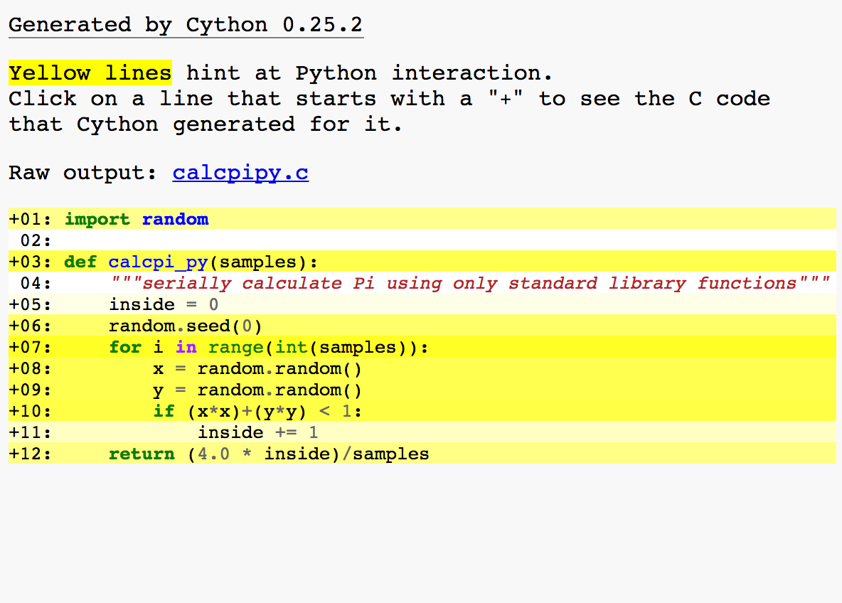
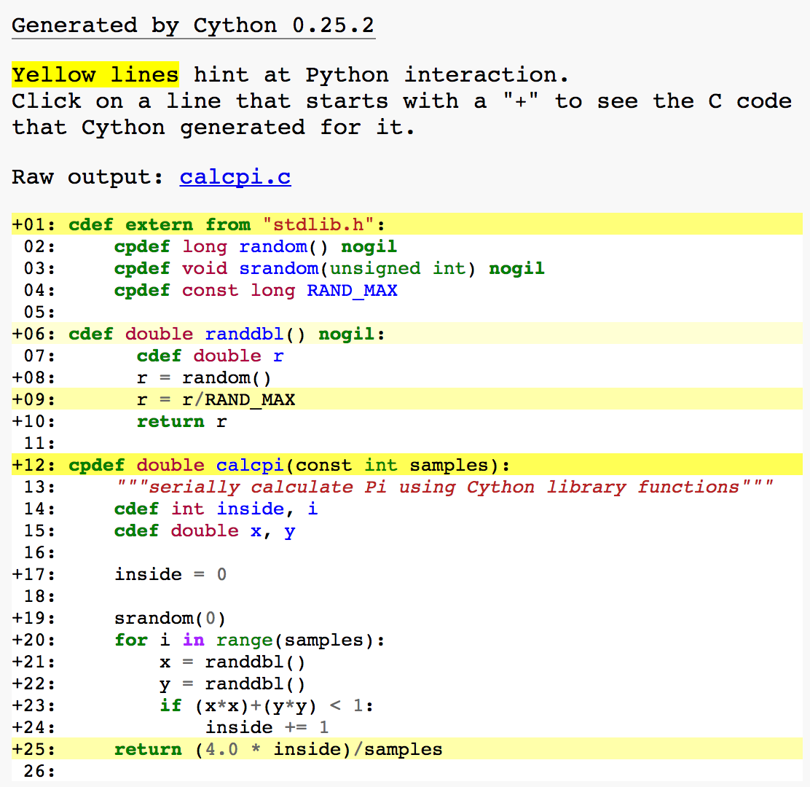
Developing Your Own Modules: Cython
Using cython -a ${sourcefile}.{pyx,py}, we can get guidance on where a module built with Cython would have to interact with CPython and lose performance:
Notes:
Plain Python: 3.85993814468

Slide 43
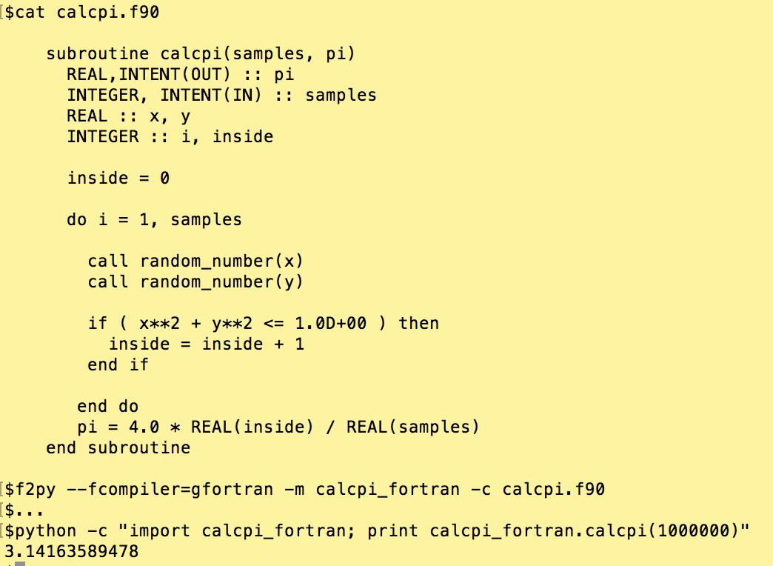
Developing Your Own Modules: f2py
f2py comes with NumPy and can be used to rapidly generate wrappers for Fortran code
Notes:
Note side effects: When a numpy array is Fortran contiguous and has a typecode corresponding to presumed Fortran type, is used as an input array argument, then its C pointer is directly passed to Fortran.
Otherwise F2PY makes a contiguous copy (with a proper typecode) of the input array and passes C pointer of the copy to Fortran subroutine. As a result, any possible changes to the (copy of) input array have no effect to the original argument, thus intent(inplace) and interface files.

Slide 44
Other Tools for Performance
There are a handful of projects that seek to improve performance of pure Python code. Two noteworthy options are:
Numba – a Python JIT
Sponsored by Continuum (now Anaconda, Inc.)
Can target CPUs and GPUs
Relies on decorators
PyPy – an alternative to CPython
Not yet 100% compatible with CPython and all modules
No code changes required

Slide 45
Python Parallelism

Slide 46
Overview of Parallel and Distributed Programming Options
threading
useful for certain concurrency issues, not really usable for parallel computing due to the GIL
subprocess
relatively low level control for spawning and managing processes, think popen
multiprocessing - multiple Python instances (processes)
basic multiple process parallelism through forked interpreters
N.B. Does not mix well with OpenMP, MPI, or shared memory tools
MPI
mpi4py exposes your full local MPI API within Python
as scalable as your local MPI
GPU (OpenCL & CUDA)
PyOpenCL and PyCUDA provide low and high level abstraction for highly parallel computations on GPUs

Slide 47
Why MPI?
It is the HPC paradigm for inter-process communications
Supported by every HPC center and vendor on the planet
APIs are stable, standardized, and portable across platforms and languages
We’ll still be using it in 10 years…
It makes full use of HPC interconnects and hardware
Abstracts aspects of the network that may be very system specific
Dask, Spark, Hadoop, and Protocol Buffers use sockets or files!
Vendors generally optimize MPI for their hardware and software
Well-supported tools for development – even for Python
Debuggers now handle mixed language applications
Profilers are treating Python as a first-class citizen
Many parallel solver packages have well-developed Python interfaces

Slide 48
Why not MPI?
Generally unsupported outside HPC contexts
Packages provided with a distribution may be highly un-tuned
Commercial cloud services generally don’t have fast interconnects
Mixing programming paradigms can be messy
MPI applications are generally synchronous – you only compute as fast as the slowest process
Generally projects use MPI+X where X is node-local
Mixing threading paradigms is generally a recipe for disaster
There can be a steep learning curve
Simple to learn, but difficult to master
APIs aren’t generally taught in CS programs
Best tools for debugging and profiling are generally commercial
Performance gains aren’t automatic

Slide 49
Python and MPI
Python was originally developed as a system scripting language for the Amoeba distributed operating system
Folks have been writing Python MPI bindings since at least 1996
David Beazley may have started this…
Other contenders: Pypar (Ole Nielsen), pyMPI (Patrick Miller, et al), Pydusa ( Timothy H. Kaiser), and Boost MPI Python (Andreas Klöckner and Doug Gregor)
The community has mostly settled on mpi4py by Lisandro Dalcin
You can mix bindings, libraries, and languages – just watch the MPI you link and your data types
ALCF has required vendor support as part of machine acquisitions since at least 2003.
Python 3 is the future – and the future is here
All major libraries now work under Python 3.5
Python 3’s loader and internals are more I/O intensive which presents challenges for scaling

Slide 50
mpi4py: why mpi4py?
Pythonic wrapping of the system’s native MPI
provides almost all MPI-1,MPI-2 and common MPI-3 features
very well maintained
distributed with major Python distributions
portable and scalable
requires only: NumPy, Cython (build only), and an MPI
used to run a Python application on 786,432 cores
capabilities only limited by the system MPI
http://mpi4py.readthedocs.io/en/stable/

Slide 51
mpi4py: running
mpi4py jobs are launched like other MPI binaries:
mpiexec –np ${RANKS} python ${PATH_TO_SCRIPT}
Just running python ${PATH_TO_SCRIPT} should always work for a single-rank case
an independent Python interpreter launches per rank
no automatic shared memory, files, or state
crashing an interpreter crashes MPI globally – like any other language
it is possible to embed a Python interpreter in a C/C++ program and use MPI from there

Slide 52
mpi4py: startup
Importing and MPI initialization:
importing mpi4py allows you to set runtime configuration options (e.g. automatic initialization, thread_level) via mpi4py.rc()
importing the MPI submodule calls MPI_Init() by default
calling Init() or Init_thread() more than once violates the MPI standard
This will lead to a Python exception or an abort in C/C++
use Is_initialized() to test for initialization

Slide 53
mpi4py: shutdown
MPI_Finalize() will automatically run at interpreter exit
use Is_finalized()to test for finalization when uncertain if a module called MPI_Finalize()
calling Finalize() more than once exits the interpreter with an error and may crash C/C++/Fortran modules

Slide 54
mpi4py and program structure
Any code, even if after MPI_Init(), unless reserved to a given rank will run on all ranks:
from mpi4py import MPI
comm = MPI.COMM_WORLD
rank = comm.Get_rank()
mpisize = comm.Get_size()
if rank%2 == 0: print(“Hello from an even rank: %d” %(rank))
comm.Barrier()
print(“Goodbye from rank %d” %(rank))

Slide 55
mpi4py and datatypes
Python objects, unless they conform to a C data type, are pickled (serialized)
pickling and unpickling have significant compute overhead
overhead impacts both senders and receivers
pickling may also increase the memory size of an object
use the lowercase methods, eg: recv(),send()
Picklable Python objects include:
None, True, and False
integers, long integers, floating point numbers, complex numbers
normal and Unicode strings
tuples, lists, sets, and dictionaries containing only picklable objects
functions defined at the top level of a module
built-in functions and classes defined at the top level of a module
instances of such classes whose __dict__() or the result of calling __getstate__() is picklable

Slide 56
mpi4py and datatypes
Buffers, MPI datatypes, and NumPy objects aren’t pickled
transmitted near the speed of C/C++
NumPy datatypes are autoconverted to MPI datatypes
buffers may need to be described as a 2/3-list/tuple [data, MPI.DOUBLE] for a single double [data,count,MPI.INT] for an array of integers
custom MPI datatypes are still possible
use the capitalized methods, eg: Recv(), Send()
When in doubt, ask if what is being processed can be represented as memory buffer or if it can only be represented in C as PyObject

Slide 57
mpi4py: communicators
Three default communicators exist at startup:
COMM_WORLD
COMM_SELF
COMM_NULL
Methods are bound to communicators e.g.: MPI.COMM_WORLD.Get_size()
Only break from the standard calls are the additional methods: Is_inter() and Is_intra()
For safety, duplicate communicators before use in or with libraries and modules you didn’t write

Slide 58
mpi4py: collectives and operations
Collectives operating on Python objects are naïve
Iterable types generally get cast to a list – this has some interesting side-effects
Operators work about the way one would expect with Python types
Collective reduction operations on Python objects are mostly serial
Casing convention applies to methods:
lowercased methods will work for general Python objects (albeit slowly)
uppercase methods will work for NumPy/MPI data types at near C speed
Notes:
Vector collectives only work on uppercase NumPy/MPI data types

Slide 59
mpi4py: crashing
If you crash or have trouble running simple codes:
Remember: CPython is a C binary and mpi4py is a binding
You will likely get core files and mangled stack traces
Use ld or otool to check which MPI mpi4py is linked against
mpi4py.get_config() will show you the contents of mpi.cfg used at build time and is generally of limited utility
Ensure Python, mpi4py, and your code are available on all nodes and libraries and paths are correct
Try running with a single rank
Rebuild binary modules with debugging symbols
The default error handler is MPI.ERRORS_RETURN which allows the use of Python exception handling, but can allow for silent death in C/C++/Fortan MPI code.
Use MPI.{Comm|Win|File}.Set_errhandler() to set MPI.ERRORS_ARE_FATAL on any communicator, memory window, or file you pass into C/C++/Fortan MPI code.
Use MPI.{Comm|Win|File}.Get_errhandler() to check the error handler on any communicator, memory window, or file passed from C/C++/Fortan MPI code.

Slide 60
Parallel I/O and h5py
General Python I/O isn’t MPI-safe
As in any other language, reads are safe though there may be locking issues
Likewise, if you must use Python I/O, write a file per MPI rank or thread
mpi4py provides full support for MPI-IO
As a wrapper, the level of support depends on your underlaying MPI
Notes:
oAll 30-something MPI-2 methods are supported
oconventional Python I/O is not MPI safe!
•safe to read files, though there might be locking issues
•write a separate file per rank if you must use Python I/O
oh5py 2.2.0 and later support parallel I/O
ohdf5 must be built with parallel support
omake sure your hdf5 matches your MPI
oh5pcc must be present
ocheck things with: h5pcc -showconfig
ohdf5 and h5py from Anaconda are serial!
oanything which modifies the structure or metadata of a file must be done collectively
oGenerally as simple as:
f = h5py.File('parallel_test.hdf5', 'w',
driver='mpio', comm=MPI.COMM_WORLD)

Slide 61
Parallel I/O and h5py
h5py 2.2.0 and later support parallel I/O
Requires mpi4py and the mpi used to compile hdf5, mpi4py, and h5py must be the same.
Beware pre-packaged h5py and hdf5 – it’s frequently serial
Confirm h5py’s MPI support before using: >>> import h5py >>> h5py.get_config().mpi True
While setup is sometime trouble, it is as easy to use as: f = h5py.File('myfile.hdf5', 'w', driver='mpio', comm=MPI.COMM_WORLD)
All changes to file structure or metadata of a file must be performed on all ranks with an open file
Notes:
oAll 30-something MPI-2 methods are supported
oconventional Python I/O is not MPI safe!
•safe to read files, though there might be locking issues
•write a separate file per rank if you must use Python I/O
oh5py 2.2.0 and later support parallel I/O
ohdf5 must be built with parallel support
omake sure your hdf5 matches your MPI
oh5pcc must be present
ocheck things with: h5pcc -showconfig
ohdf5 and h5py from Anaconda are serial!
oanything which modifies the structure or metadata of a file must be done collectively
oGenerally as simple as:
f = h5py.File('parallel_test.hdf5', 'w',
driver='mpio', comm=MPI.COMM_WORLD)

Slide 62
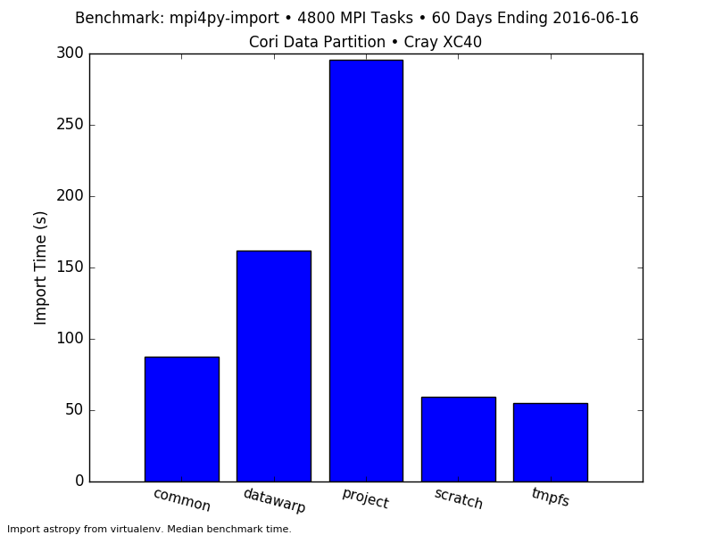
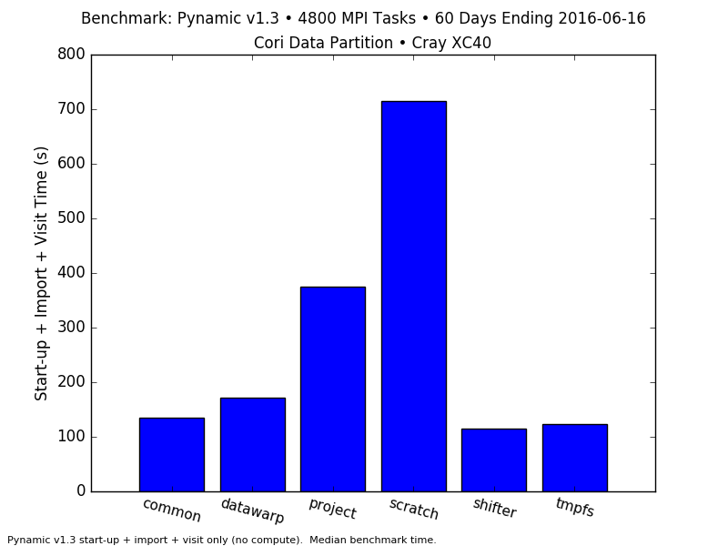

Issues Affecting Python at Scale
worse
GPFS
DVS R/O Caching
better
Burst
Buffer
GPFS
Lustre
Python’s “import” statement is file metadata intensive (.py, .pyc, .so open/stat calls).
Becomes more severe as the number of Python processes trying to access files increases.
Result: Very slow times to just start Python applications at larger concurrency (MPI).
Storage local to compute nodes, use of containers (Shifter) helps fix:
Eliminates metadata calls off the compute nodes.
In containers, paths to .so libraries can be cached via ldconfig.
Other approaches:
Ship software stack to compute nodes (e.g., python-mpi-bcast).
Install software to read-only/cache-enabled file systems.
See also Spindle or collfs (Scalable Shared Library Loading).

Slide 63
Hands-on Exercise 2: Using mpi4py
Instructions:
Grab a node: salloc -N 1 -q regular -t 240 -C haswell -A ntrain --reservation=ecp_python
Activate the environment setup earlier: source activate myenv
Change to the directory basics cd ~/ecp_python_tutorial/basics
Run basic_features.py on 8 ranks: srun -n 8 -c 1 python basic_features.pybasic_features.py

Slide 64
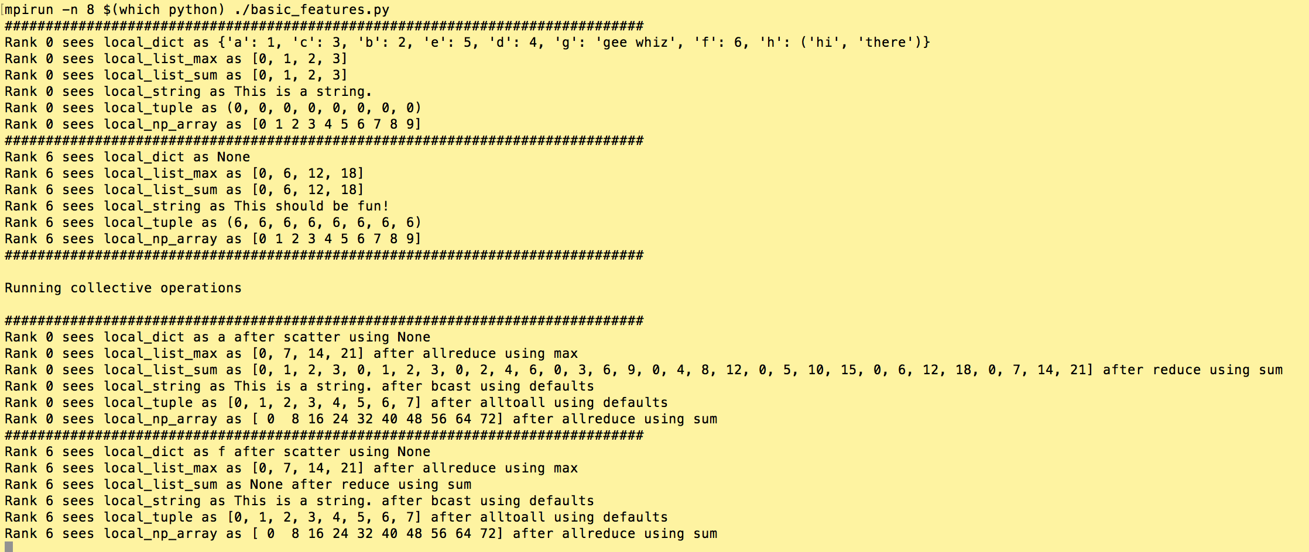
Hands-on Exercise 2: Using mpi4py (part 2)
Instructions:
Output should look like:

Slide 65
Hands-on Exercise 2: Using mpi4py
Why wasn’t our output in order?
How might we scatter a dictionary?
Change to the directory pi cd ~/ecp_python_tutorial/pi
Run builtins_mpi_pi.py on 1, 8, and 16 ranks: srun -n 1 -c 1 python builtins_mpi_pi.py srun -n 8 -c 1 python builtins_mpi_pi.py srun -n 16 -c 1 python builtins_mpi_pi.py
Run threads_pi.py with 1, 8, and 16 threads with the same sample count: ./threads_pi.py 12000000 1 ./threads_pi.py 12000000 8 ./threads_pi.py 12000000 16
What does this tell us about native Python threads?

Slide 66
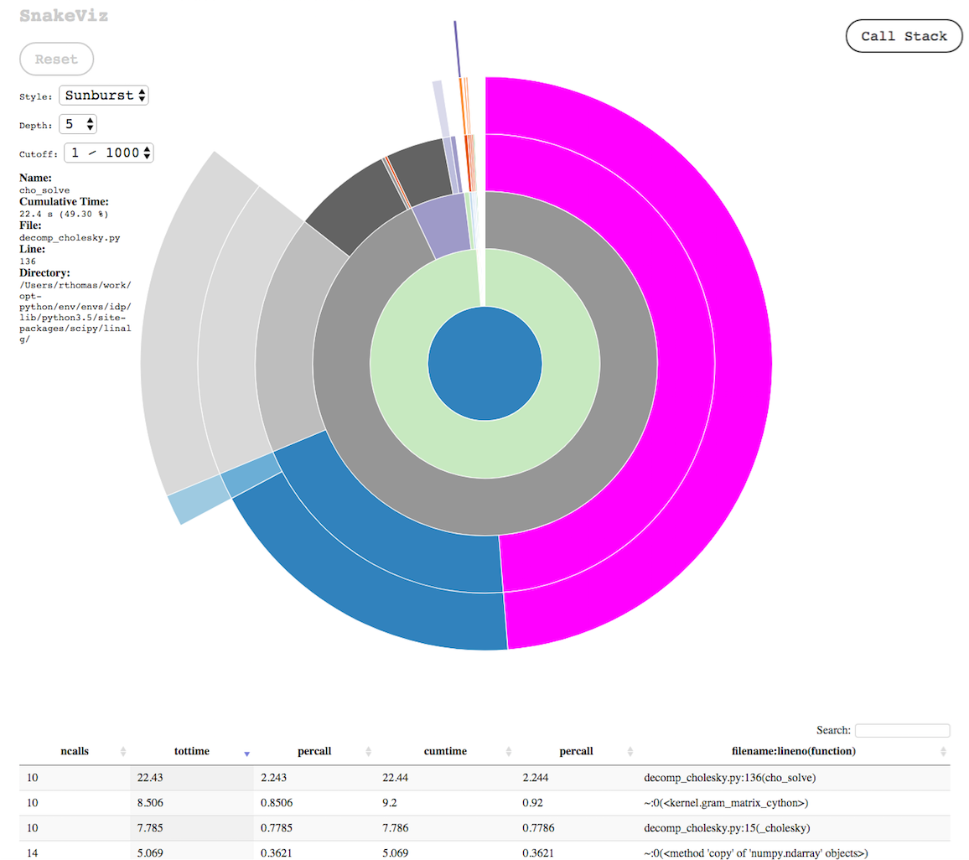
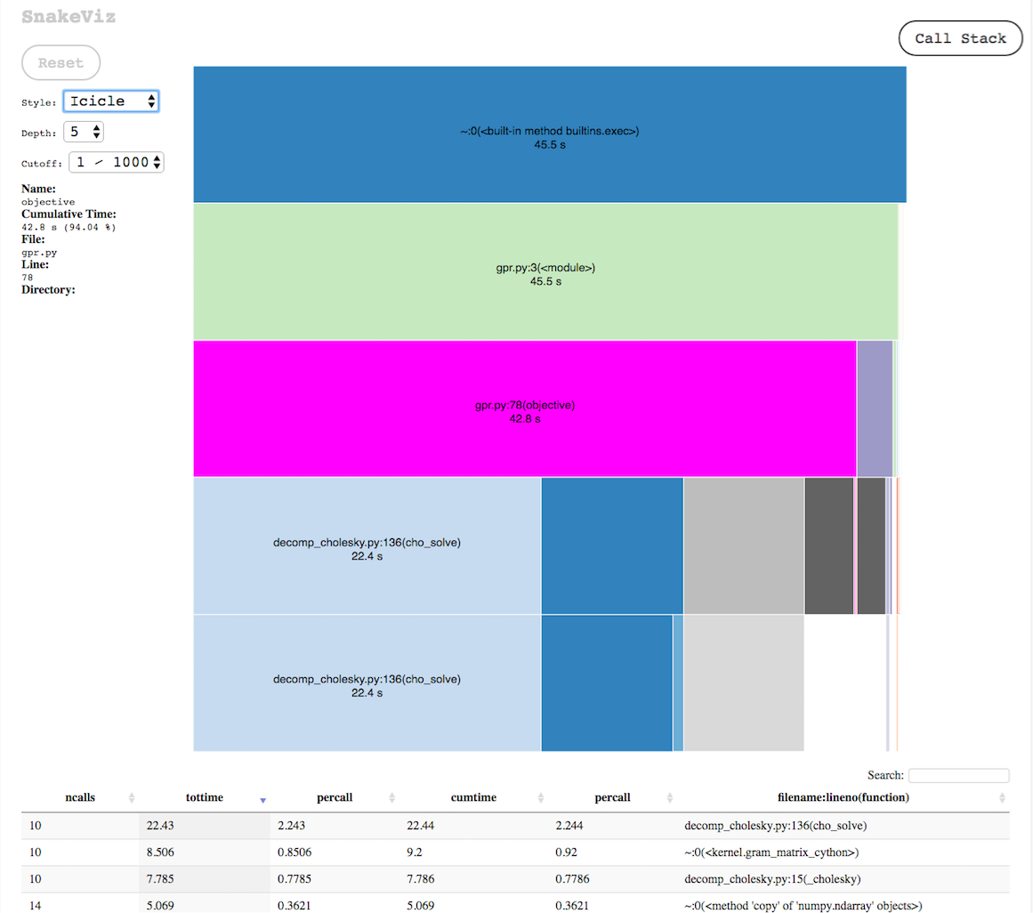
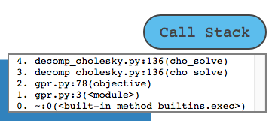
Basic Profiling: cProfile & SnakeViz
cProfile
Low-overhead profiler, from standard library.
Outputs statistics on what your code is doing:
Number of function calls,
Total time spend in functions,
Time per function call, etc.
[https://docs.python.org/2/library/debug.html] [https://docs.python.org/2/library/profile.html#module-cProfile] [https://docs.python.org/2/library/profile.html#the-stats-class]
SnakeViz
Lets you visualize cProfile output in a browser:
Statistics mentioned above.
Visualize call stack & drill-down.
> python -m cProfile -o out.prof my-program.py
...
> snakeviz out.prof
snakeviz web server started on 127.0.0.1:8080…
[https://jiffyclub.github.io/snakeviz/]

Slide 67
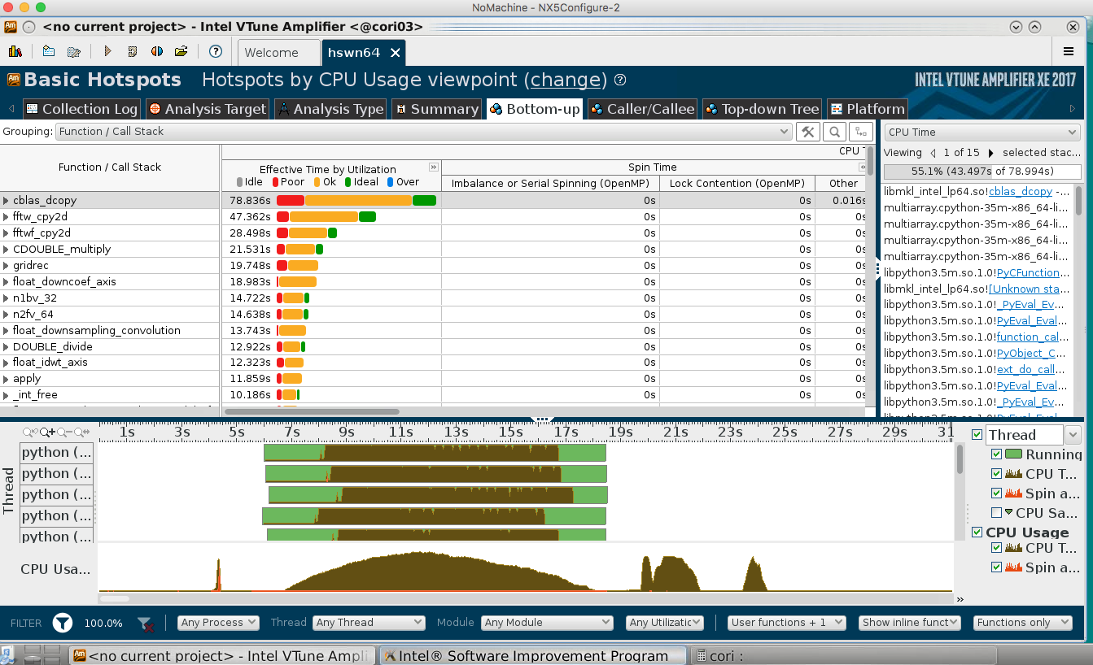
Intel VTune Works with Python Code
VTune Amplifier
Performance analysis profiler.
GUI and command-line interface.
Thread timelines.
Hotspot analysis.
Memory profiling.
Locks & waits.
Filter/zoom in timeline.
Run GUI (amplxe-gui) over NX!
[https://software.intel.com/en-us/node/628111]
[https://software.intel.com/en-us/videos/performance-analysis-of-python-applications-with-intel-vtune-amplifier]
Part of Intel Parallel Studio, may be available as a module, e.g. at NERSC:
> module load vtune
> salloc … --perf=vtune
…
> srun … amplxe-cl -collect hotspots python my-app.py
Best practice on KNL:
-no-auto-finalize, archive and -finalize on e.g. Haswell node
[e.g. http://www.nersc.gov/assets/Uploads/04-vtune.pdf]
Intel Tools Screenshots of TomoPy analysis
courtesy Zahra Ronaghi, NERSC

Slide 68
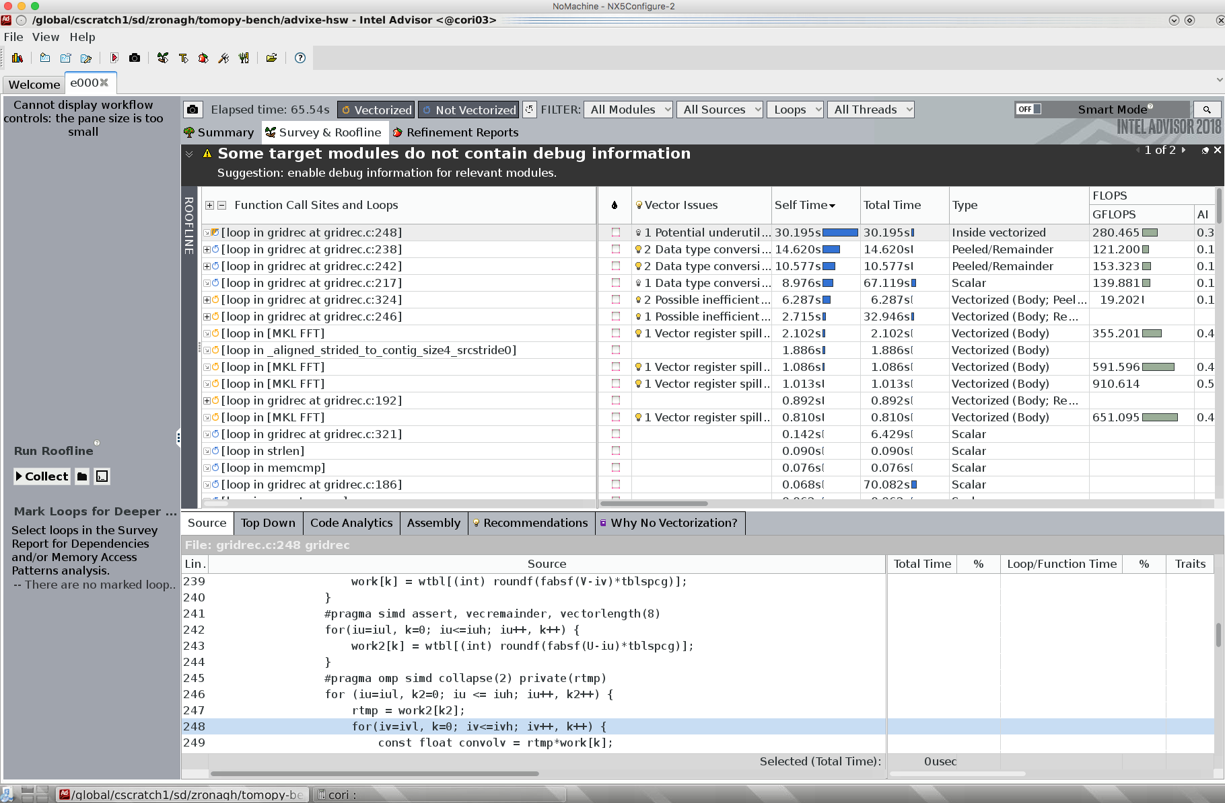
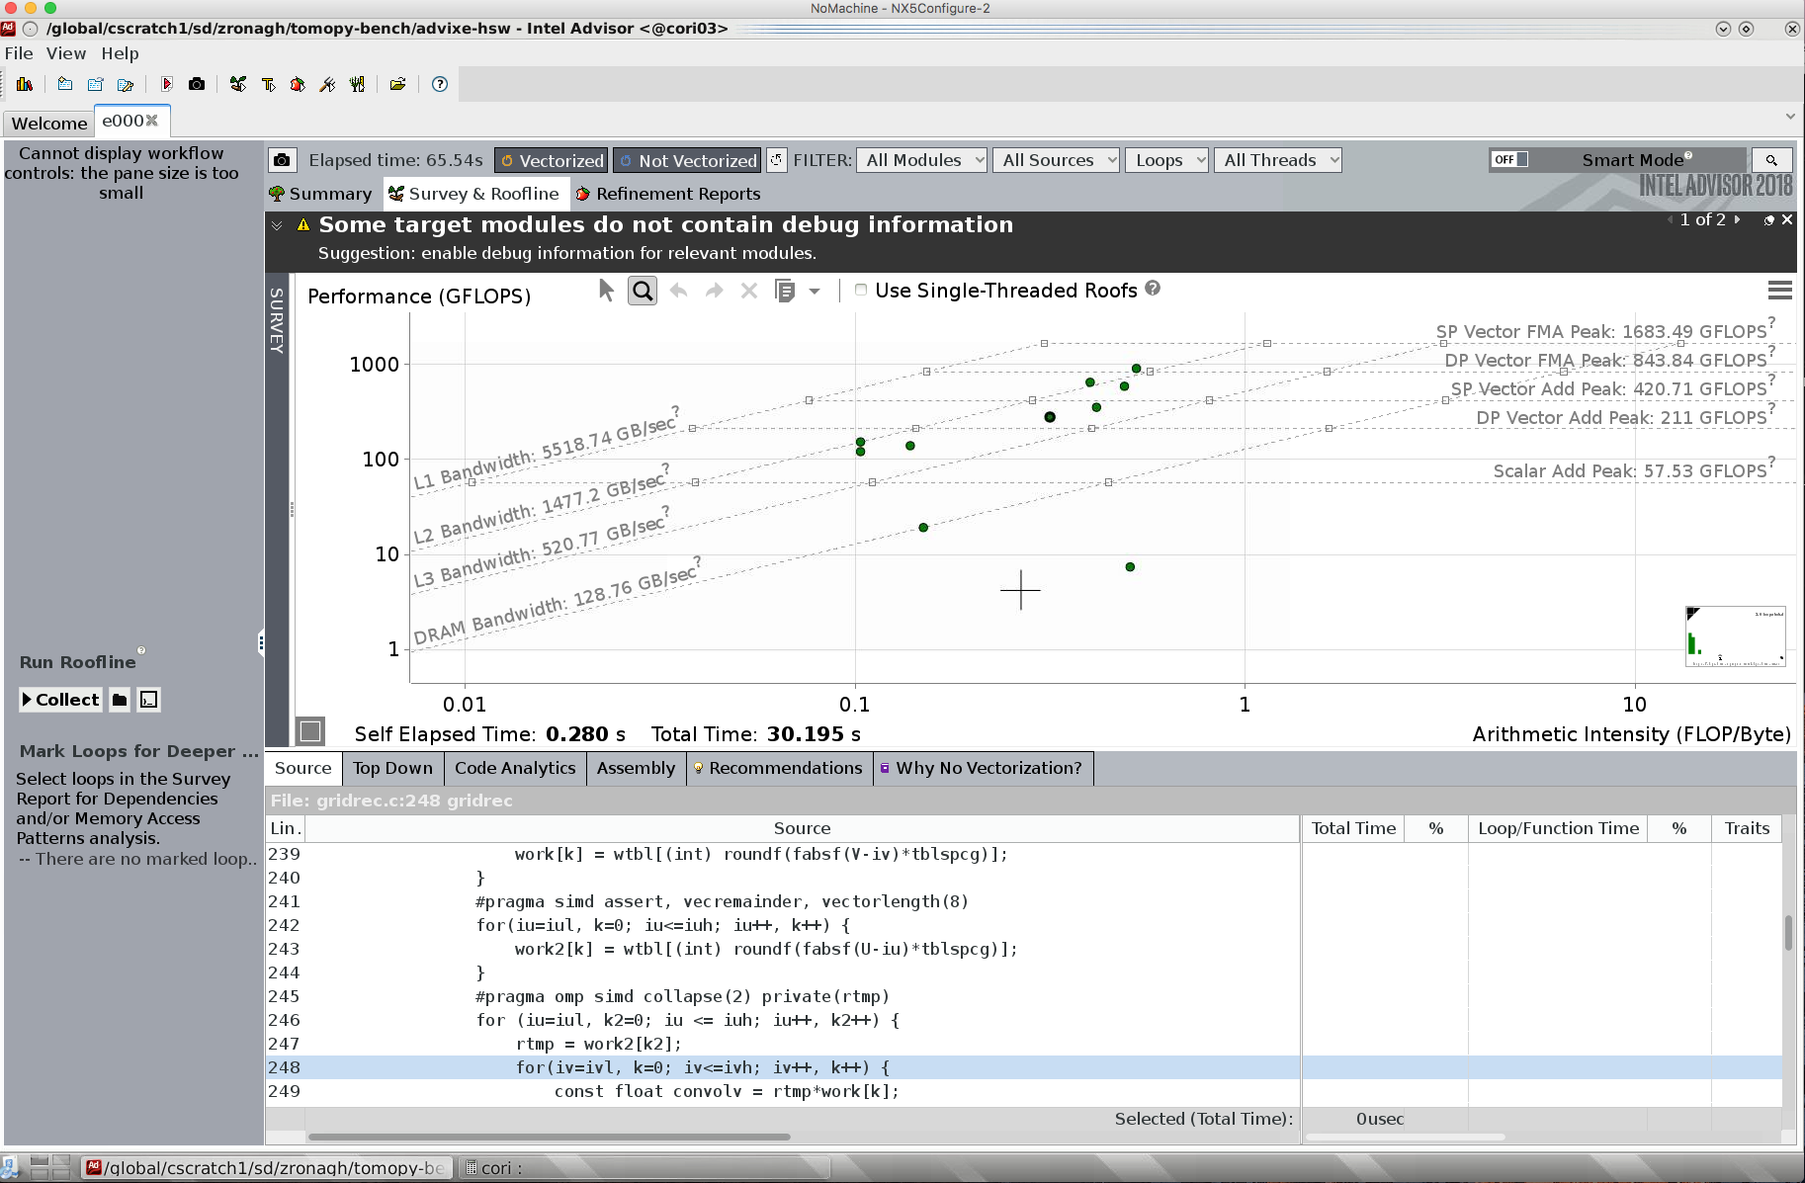
Intel Advisor Works with Python Code
What should I do next? When do I stop?
Suggests optimizations for your C extensions.
Point out vectorization opportunities.
Optimize use of threads.
Works with Python and C/C++/Fortran code.
Roofline analysis*:
Performance of code in relation to hardware limits.
Memory bandwidth or compute bound?
[* Roofline: An upcoming IDEAS Webinar topic.]

Slide 69

Getting Started with Python Resources
https://www.python.org/about/gettingstarted/
https://wiki.python.org/moin/BeginnersGuide
https://www.codecademy.com/learn/python
https://www.coursera.org/specializations/python
https://software-carpentry.org/lessons/
https://pymotw.com/
https://xkcd.com/353/

Slide 70
More Resources
Your NERSC and LCF Python contacts:
NERSC: Rollin Thomas rcthomas@lbl.gov
ALCF: William Scullin wscullin@alcf.anl.gov
OLCF: Matt Belhorn belhornmp@ornl.gov
Documentation:
NERSC: http://www.nersc.gov/users/data-analytics/data-analytics/python/
OLCF: https://www.olcf.ornl.gov/training-event/2016-olcf-user-conference-call-olcf-python-best-practices/
Other presentations:
ALCF Performance Workshop (May 2017): Python on HPC Best Practices http://www.alcf.anl.gov/files/scullin-python.pdf
NERSC Intel Python Training Event (March 2017):
Optimization Example http://www.nersc.gov/assets/Uploads/Intel-tomopy-Mar2017.pdf by Oleksandr Pavlyk (Intel)

Slide 71
Conclusion
NERSC, ALCF, and OLCF recognize, welcome, and want to support new and experienced Python users in HPC.
Using Python on our systems can be as easy as a module load, but can be customized by users.
We have provided some guidance and best practices to help users improve Python performance in HPC context.
Try out some of the profiling and performance analysis tools described here, and ask for help if you get stuck.
While there are many challenges for Python in HPC, if users, staff, & vendors work together, there are many rewards.

Slide 72
Thank you!

Slide 73
Cross-Compiling on Cray XC30s with pip
Instruct Cray compiler wrappers to target the login node architecture so code will run everywhere module unload craype-interlagos module load craype-istanbul virualenv --python=python2.7 "${VENV_NAME}" source "${VENV_NAME}/bin/activate" # If pip is badly out of date, the TLS certificates may not be trusted. pip install --trusted-host pypi.python.org --upgrade pip Set envvars needed to guide pip for cross-compiling and instruct it to build from source CC=cc MPICC=cc pip install -v --no-binary :all: mpi4py Set envvars needed for pip to use external dependencies. See package documentation. HDF5_DIR="${CRAY_HDF5_DIR}/${PE_ENV}/${GNU_VERSION%.*}" CC=cc HDF5_MPI="ON" HDF5_DIR="${HDF5_DIR}" pip install -v --no-binary :all: h5py deactivate "${VENV_NAME}" module unload craype-istanbul module load craype-interlagos

